Slide 1

Alibaba Culture and Working
李龙来(Kevin Li)
Senior Developer
Citi Tech department

Slide 2
Contents
01
Alibaba life
02
Alibaba Translation Team
03
Ali engineering technology
04
How to do a project in Alibaba

Slide 3
01
Alibaba life
PART ONE

Slide 4
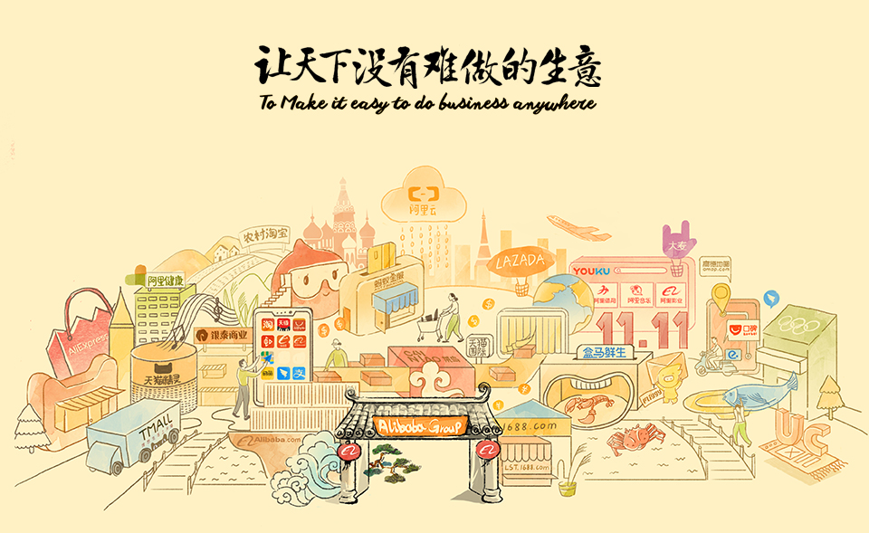
Ali translator-why need

Slide 5
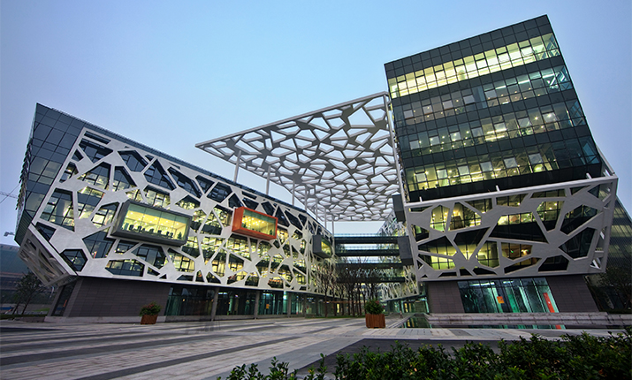
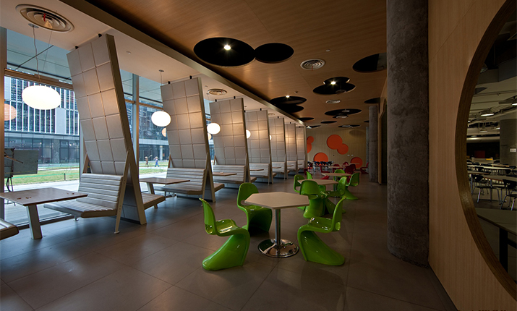
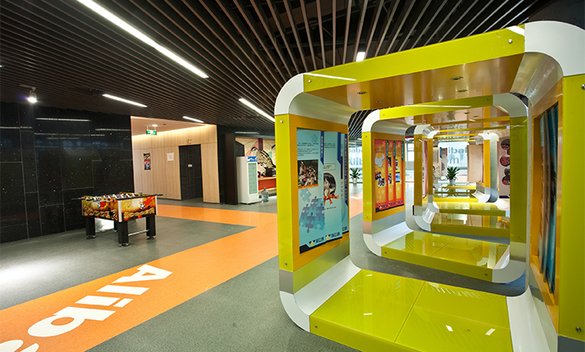
office

Slide 6
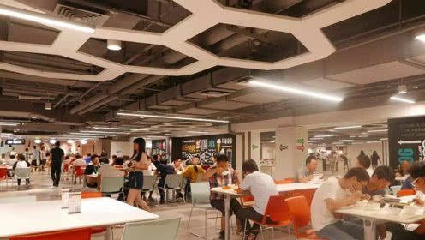
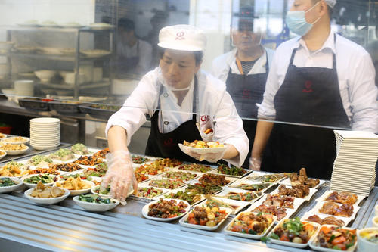
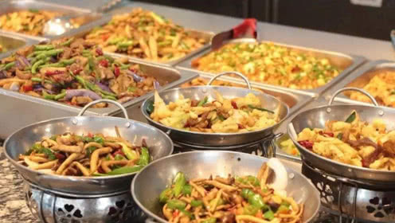
restaurant

Slide 7
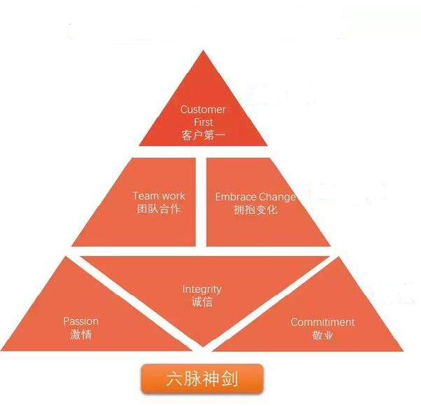
Value and Hope
Value
Customer First
请在此插入图片
Team work
Embrace Change
Integrity
Passion
Commitment
Hope
Group will survive 102

Slide 8
02
Alibaba Translation Team
PART TWO

Slide 9
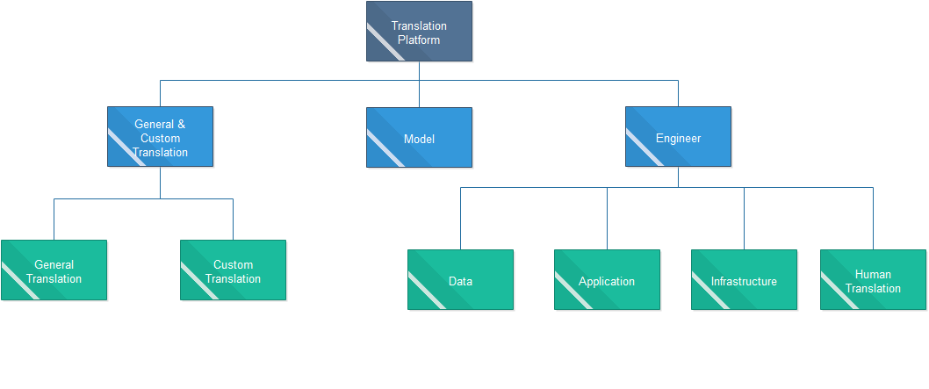
Ali translator-team
Base in Hangzhou, Beijing, US
请在此插入图片
Over 40 Researchers and engines
Group
Algorithm, Data, Infrastructure, Application, Crowd Source

Slide 10
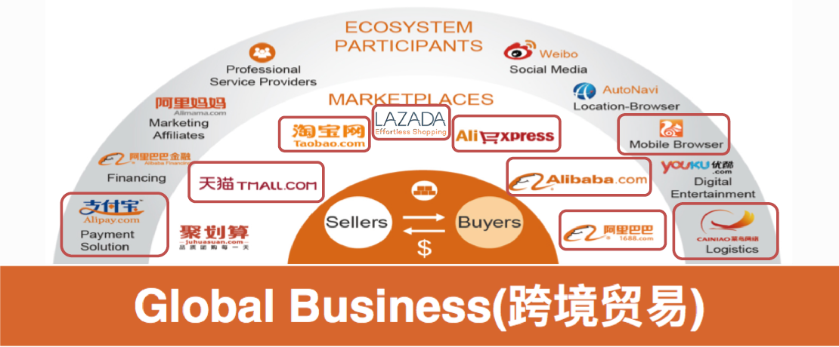
Ali translator-business side

Slide 11
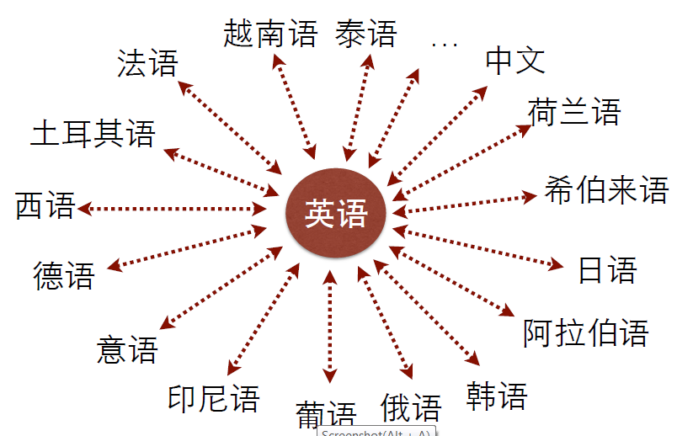
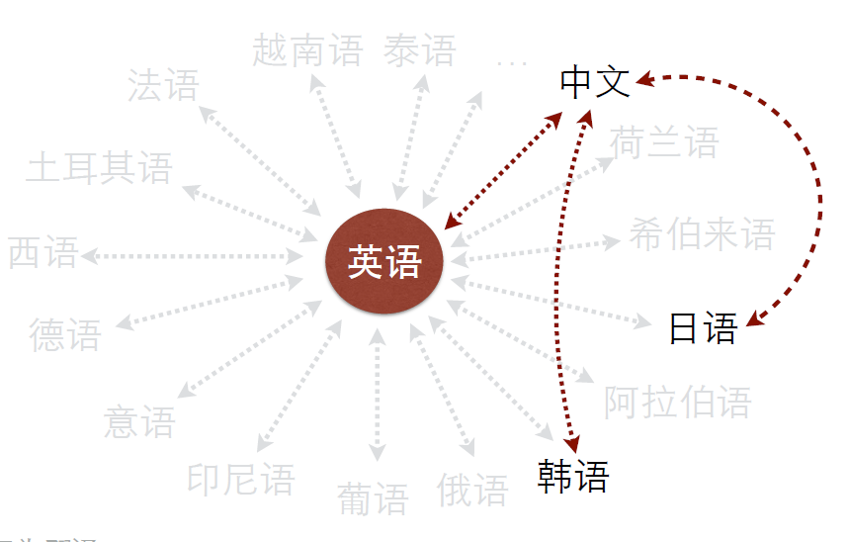
Ali translator-capacity

Slide 12
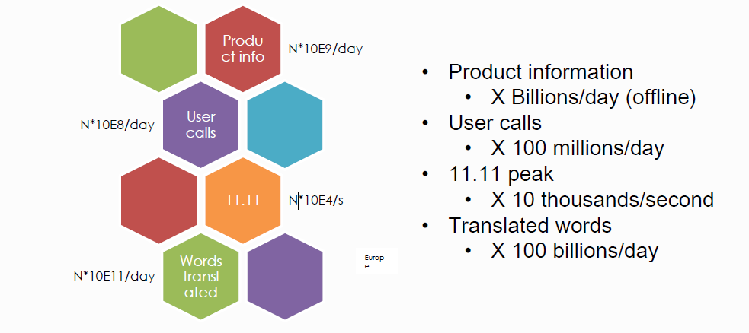
Ali translator-capacity

Slide 13
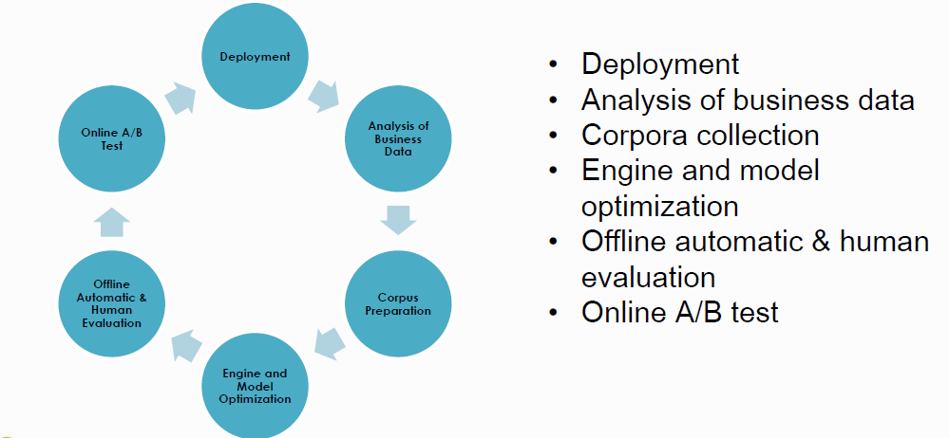
Ali translator-Translator Lifecycle

Slide 14
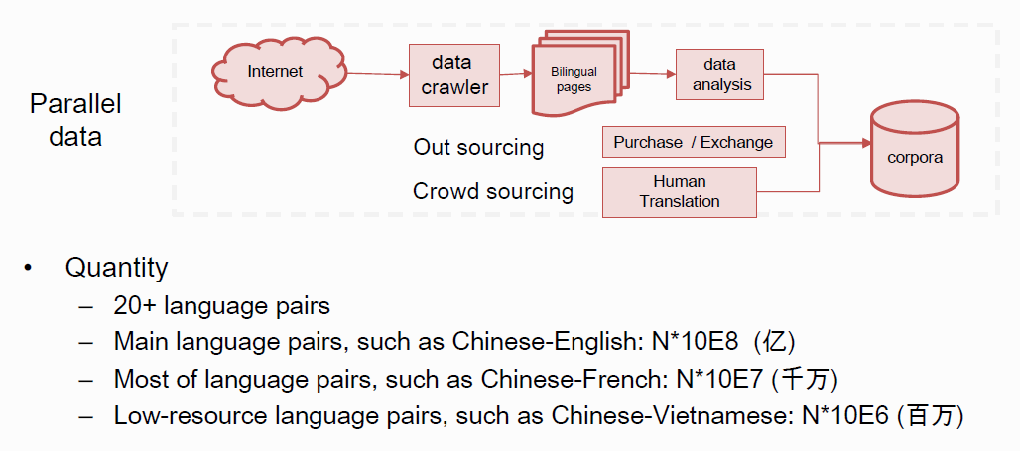
Ali translator-data

Slide 15
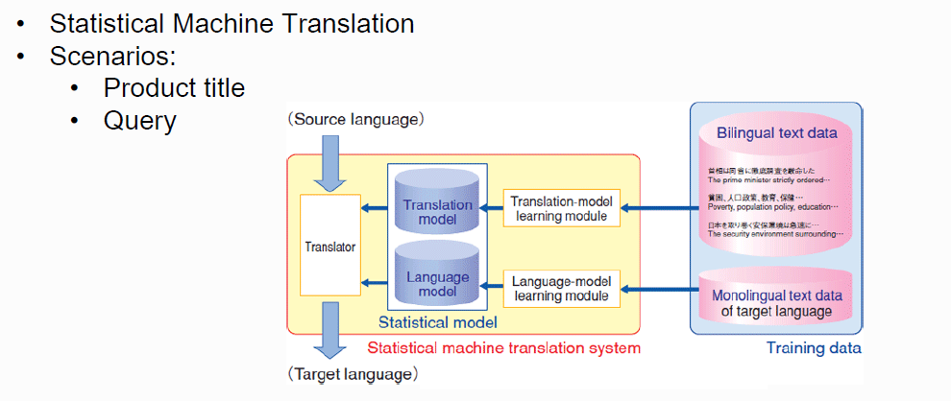
Ali translator-model

Slide 16
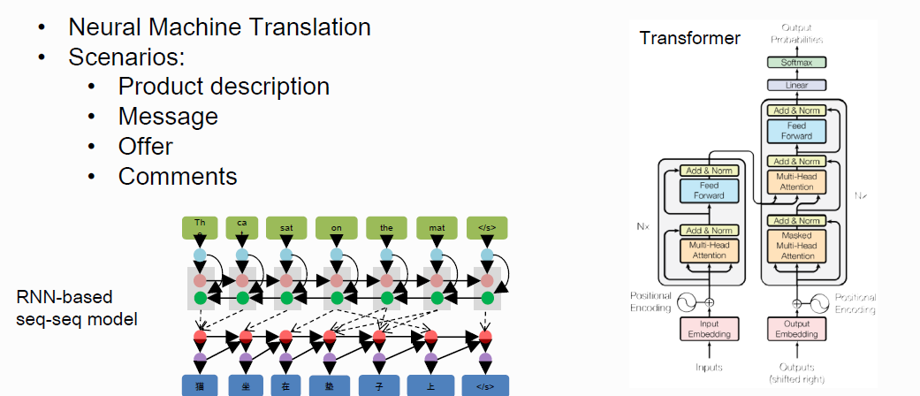
Ali translator-model

Slide 17
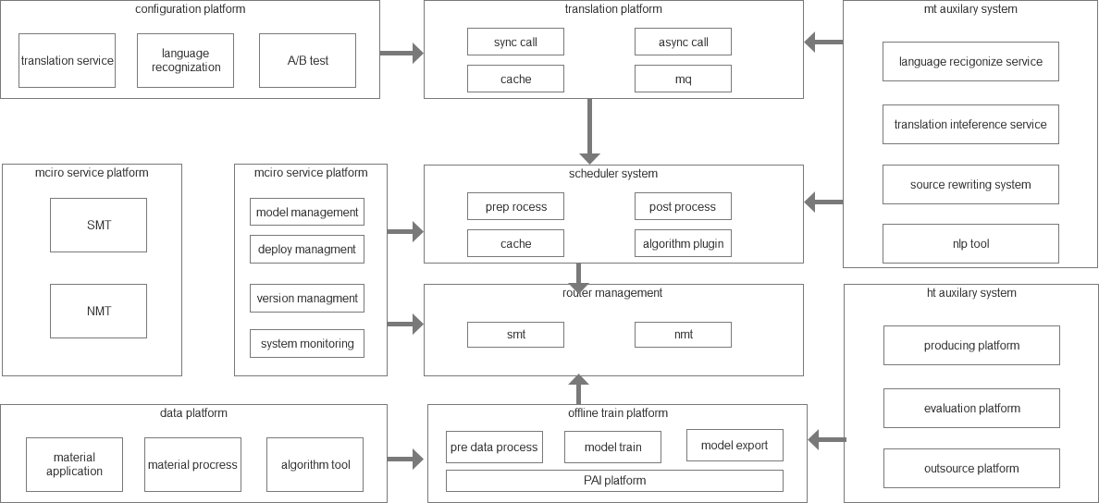
Ali translator-application

Slide 18
03
Ali engineering technology
PART THREE

Slide 19
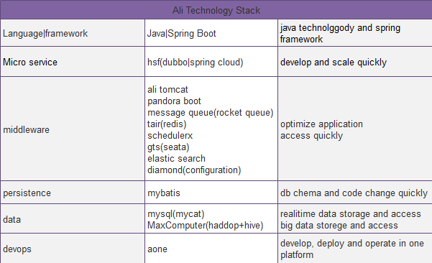
Ali engineering technology
No IOE
Micro service
Platform

Slide 20
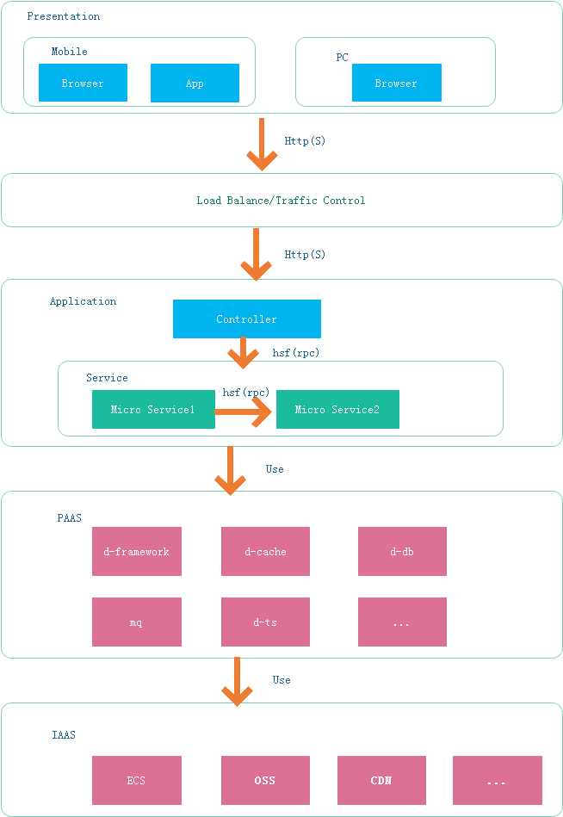
Ali-application framework

Slide 21
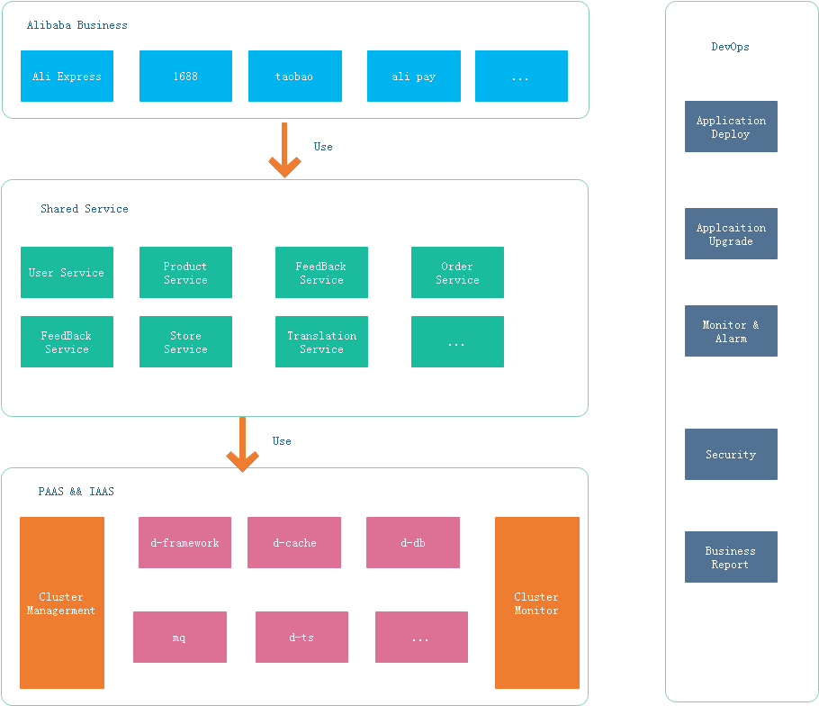
Ali-middle ground framework

Slide 22
04
How to do a project in Alibaba
PART FOUR

Slide 23
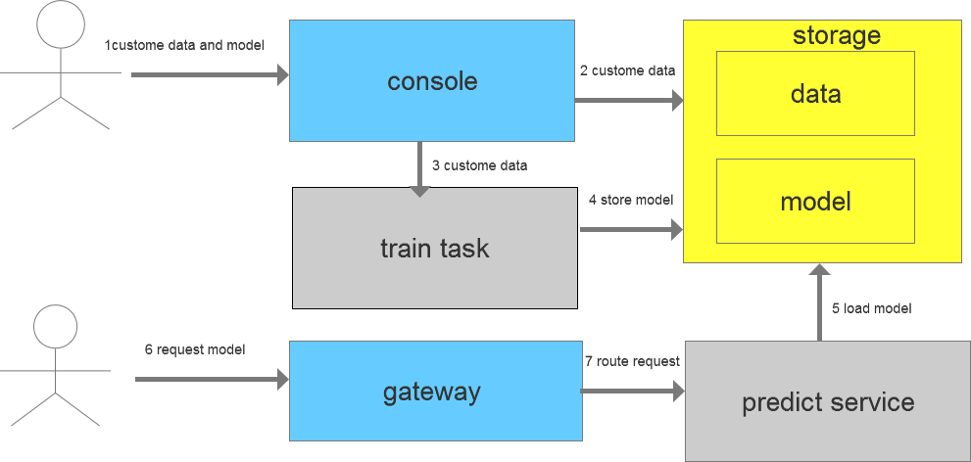
Ali-how to do project(nlp)

Slide 24
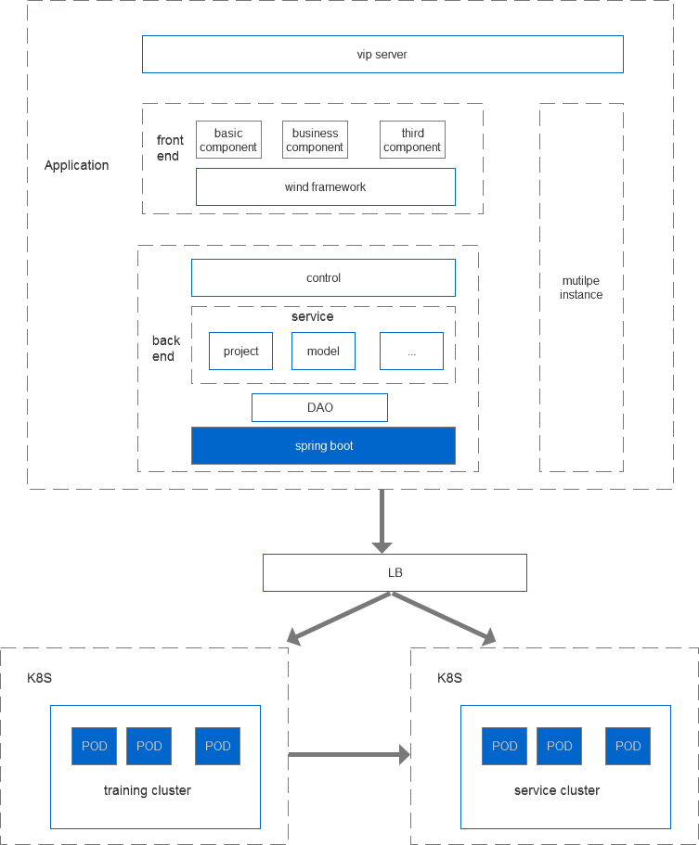
Ali-how to do project(nlp)

Slide 25
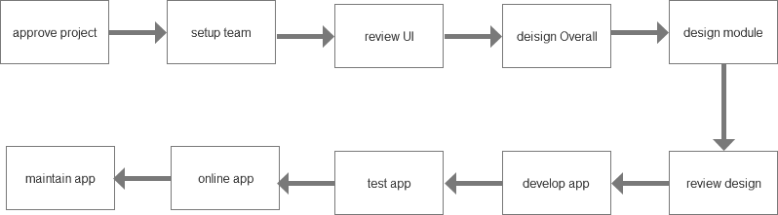
Ali-how to do project

Slide 26
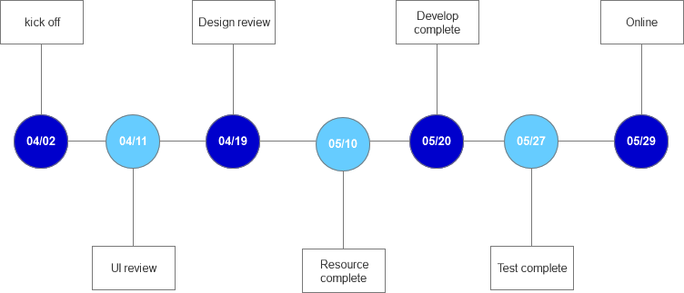
Ali-how to do project

Slide 27
Thanks
THANKS FOR YOUR TIME
李龙来(Kevin Li)
Senior Developer
Citi Tech department

